Slide 1
Bullet Hell Dungeon
Jonathan Sarasua

Slide 2


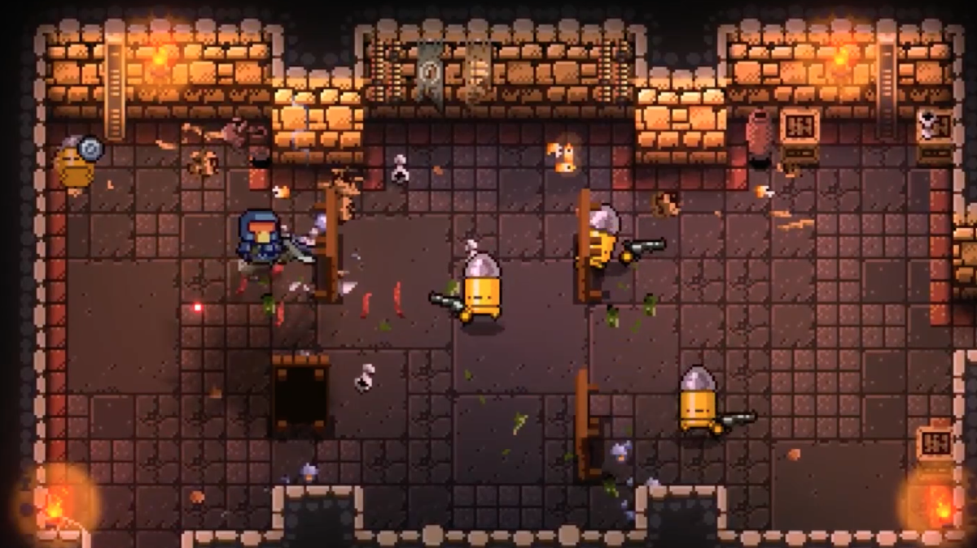
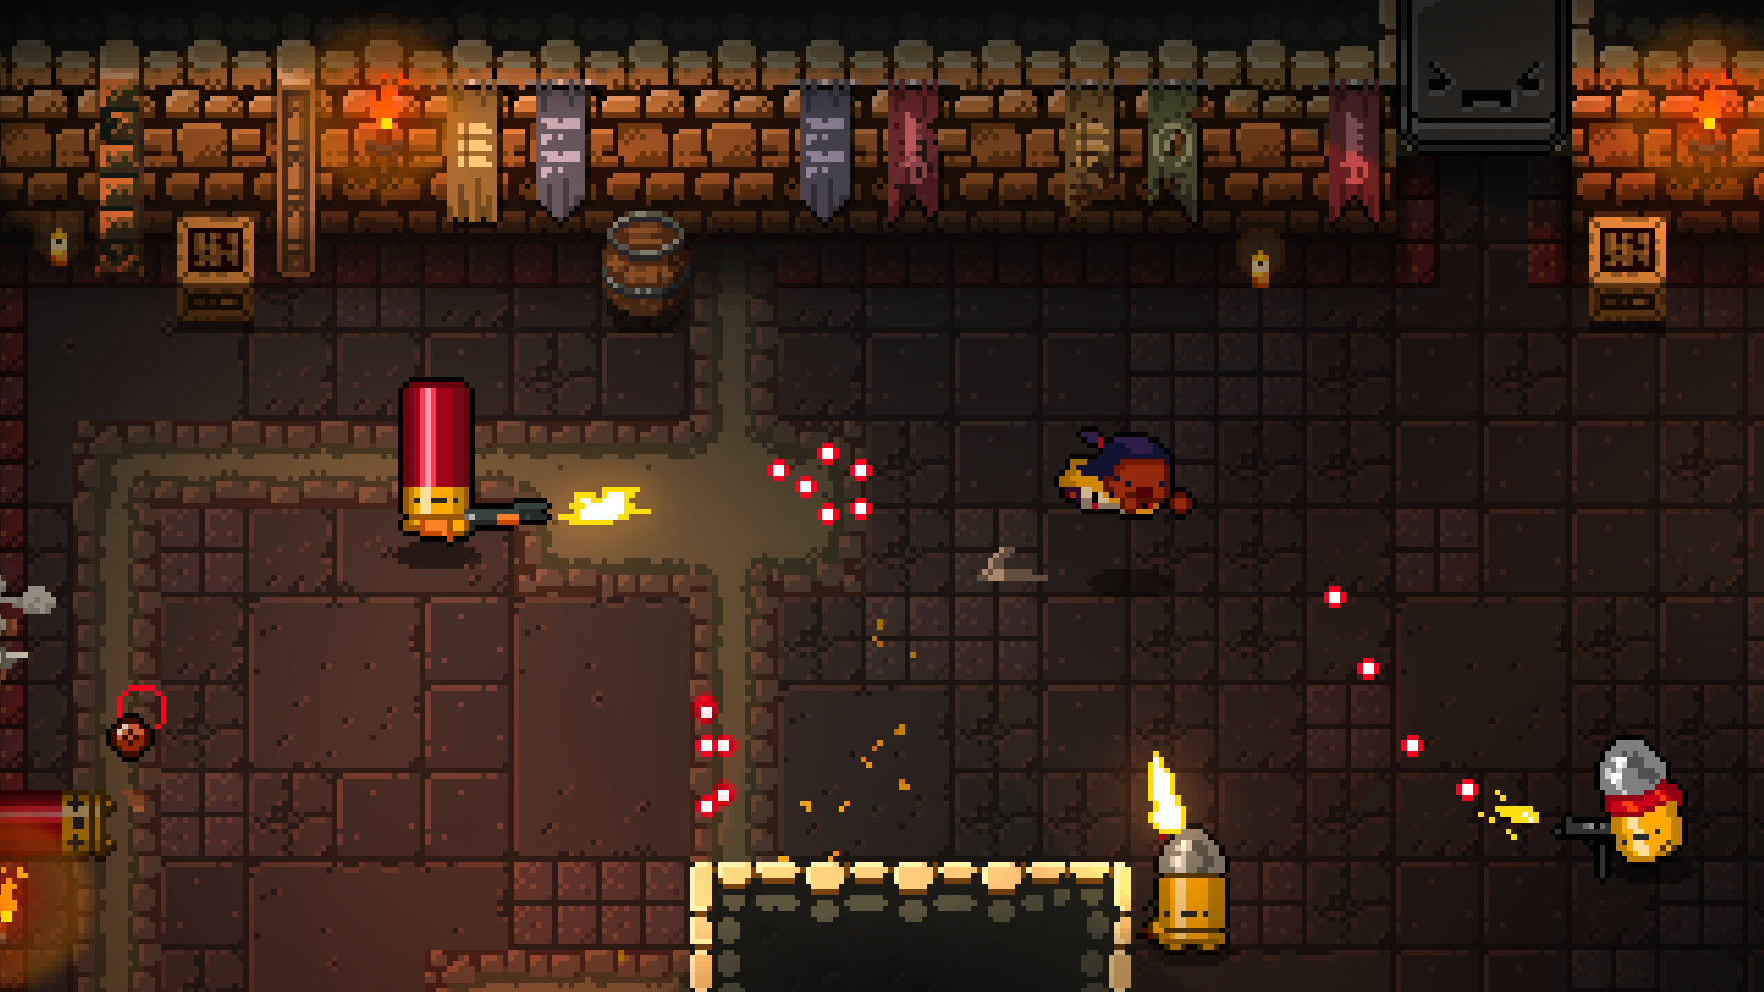
Gameplay
Lots of bullets
Lots of guns
Somehow dodge everything
Win
Incursion on Super Steroids
This Photo by Unknown Author is licensed under CC BY-SA-NC
This Photo by Unknown Author is licensed under CC BY-SA-NC

Slide 3
Milestone 1
Milestone 1 goal
Create the data driven actors, weapons, bullets, etc. and allow the player to walk around and shoot
Focus on building architecture
Simple AI
Basic loading screen and menu
Achievements
Basic Map (using Adventure base game)
Basic weapon, bullets, walking, and shooting
Simple AI
Basic loading screen and menu

Slide 4
Milestone 1 Analysis
Hours
Original estimate: 27
Actual: 28.25
Inaccurate hours/not done: 10.75
Unplanned hours: 12
Lessons learned
Plan/choose base project wisely
Start early to find issues

Slide 5
Milestone 2
Build HUD/Menu/Pause Screen
Build out first level
Room locking/spawning
Boss fight
Implement dodge
Teleport initially
Cleanup/Add weapons
Fix character assets to work with weapons
Line up bullets with weapon asset
Flamethrower/shotgun/pistol

